Slide 1
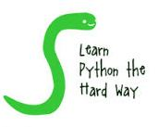
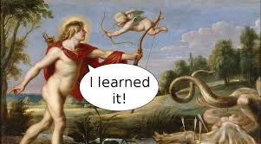
Python
Basics
Peter Wad Sackett

Slide 2
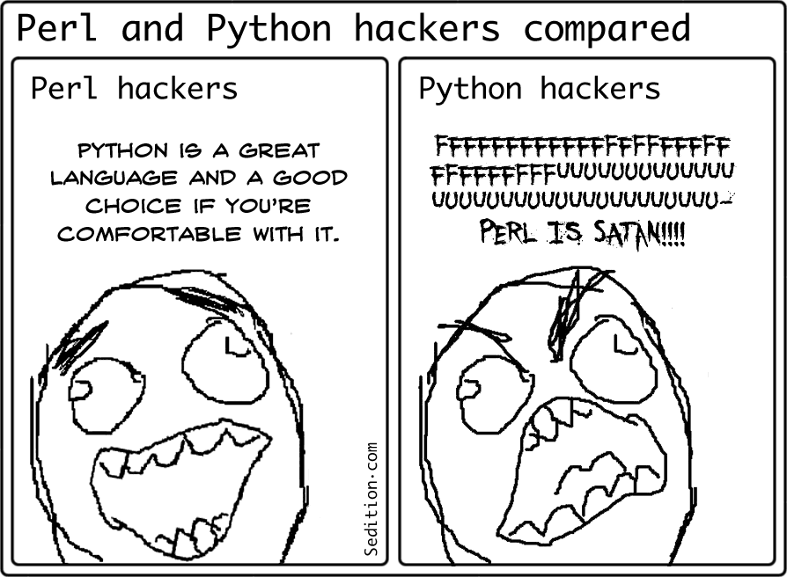
Reasons to learn Python
Some commonly acknowledged reasons
Short development time
Learning curve is not so steep as other languages
Anaconda is a big self contained Python distribution
Large library base
Runs on many platforms
Some more personal reasons
I like a challenge
My supervisor tells me to
I want to have fun
My cool friends in bioinformatics use Python

Slide 3

Problems with Python
Python 2
More popular
Old
Some future changes can be imported
Larger library base
Python 3
Better performance
Future orientated
Some design flaws have been corrected
Library base is big enough
Python is more geared towards finding solutions instead of solving problems. The difference is in the level of understanding.

Slide 4
Computer problems – your problems
The computer is the fastest idiot you will ever meet.
This means that you must understand the problem, and be able to give precise instructions to the computer about how to solve it.
Python is one of many languages in which you can tell the computer what to do. Every spoken language has some grammar which must be obeyed or it will sound strange. In computer languages this is called syntax and it must be correct – or else........
Secret, shall I tell you? Grand Master of Jedi Order am I. Won this job in a raffle I did, think you? “How did you know, how did you know, Master Yoda?” Master Yoda knows these things. His job it is.
As in any language, just because the grammar/syntax is correct, it does not follow that what you say/code is meaningful.
http://nonsense.x2d.org/
http://sebpearce.com/bullshit/

Slide 5
How to make a program ?
A Python program is a number of statements in a text file, which name usually ends with .py. These statements can seem cryptic in the beginning, just like any other language that you do not know.
You can create the Python text file in a number of ways, the easiest is using a text editor. This has been shown in the Unix lesson.
Assuming a Unix-like system, then the very first line of the program has to be:
#!/usr/bin/env python3
which is telling the system that the following text is to be understood as a Python program.
Assuming that the Python text file is called myprog.py, then it can be made executable (see Unix lesson) by typing:
chmod a+x myprog.py
at the command line (done once). It can then be executed by
./myprog.py

Slide 6
Other ways to run a Python program
There are some programming environments, where Python statements can be executed. The most popular are spyder and jupyter. These are not part of the course curriculum and no help with be available on these tools.
Teacher opinion: These tools do not exists on the servers, where you are going to run real programs – they are simply not meaningful to have available. They also pose some memory and performance restrictions on the programs. Best not to get used to them.
Student opinion: They give such a nice visual environment where testing your program becomes easy and you can see the state of your variables at all times.
Teacher: Sure, it is a crutch. Don’t make a beginners mistake and make it replace real thinking.
Pick your poison. The following slides will go through the basic statements of the Python language.

Slide 7
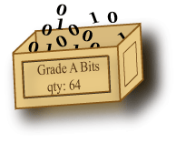
Python language start
Every programming language has some way of expressing:
Values
Operations on values
Assignments
Input/output operations
Conditional actions
Repeated actions
There is almost always some built-in primitive functions, like ”what’s the time?” or ”what’s the logarithm of this number?”

Slide 8
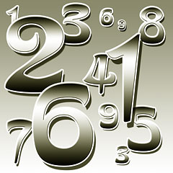
Values
Numbers – not much of a surprise
Integers: 3
Negative: -6
Floating point: 2232.435
Strings – think quoted text
Single quotes: ’I am a string’
Double quotes: ”Me too, no difference”
You can use three quotes: ”””String, I am”””
Gives you opportunity to write a string easier, if it contains weird chars like other quotes.

Slide 9
Operations on values
Standard math operations
Addition: 5 + 6 11
Subtraction: 7.6 – 9 -1.4
Multiplication: 5.7 * 3 17.1
Division: 7 / 5 1.4
Modulo: 32 % 5 2
String operations
Addition: ’My’ + ’Name’ ’MyName’
Multiplication: 3 * ’Ha’ ’HaHaHa’
The characters + - * / % are called operators.
There are more operators and operations, that can be performed on values, but going into these will confuse the issue. Many operations are functions, like log(number) that returns the logarithm of the number.

Slide 10
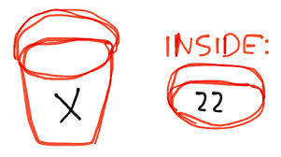
Variables
A variable is a symbol that contains a value, that might change over time. It represents a piece of the computer’s memory that is used to store the value.
Any word which is not reserved in Python can be used as a variable.
A variable name may contain alphanumeric characters and underscore.
Case matters.
A simple variable can be either a string, integer or floating point number, but does not need to be declared as any specific type. However, it is implicitly of a certain type.
Examples: var1, i, MyCount, remember_this.
Most importantly, the name of the variable should reflect the kind of information that is stored in the variable. That will make a program much more understandable, both when writing it and later when reading it.
name, age and height are good variables to store a person’s name, age and height in. This seems obvious, but apparently it is not.

Slide 11
Assignment - basic
A variable assignment is a python statement
name = ’Peter Wad Sackett’
height = 173 # in cm
weight = 74.5 # in kilograms
BMI = weight / ((height/100)*(height/100))
The variable that is assigned a value is always on the left side.
A # is used to denote a comment. Anything after a # is ignored on that line (with few exceptions).
The value can be simple strings/numbers or a more complex calculation, which evaluates to a simple measure. Parentheses are here used to show the evaulation order of the BMI calculation.
A variable has to be assigned a value first, before it can be used for anything else at all.

Slide 12
Assignment - advanced
An assignment can be combined with an operator
Example – adding 10 to a variable:
result = result + 10 # normal way
result += 10 # shortcut
Example – adding to a string (often used):
string += ’This is added to the end of the string’
Strings and numbers are immutable (important concept). They do not change, instead they are deleted and created anew. This gives the appearance of being changeable.
Other data types, typically collection types (f.ex. lists or sets), are mutable, i.e. changeable.

Slide 13
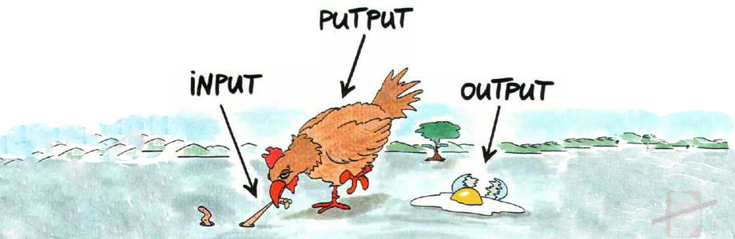
I/O – input/output
I/O operations are essential in all programming languages.
You must be able to feed data to your program and you must be able to extract results. That is input and output.
There are many input methods: mouse, keyboard, voice, file, etc.
Also many output methods: screen, sound, file, etc.
In Python, they are mainly boiled down to reading and writing files.
The screen and the keyboard can be treated as files.

Slide 14

Input – from the keyboard
Getting input from the keyboard
Input is assigned to a variable
data = input()
Notice that you press the <ENTER> key to make the program accept your data.
That <ENTER> (newline) does NOT become part of the input.
The input is a string.
The input function can also write a string on the screen, so when the program waits for input from the keyboard, it becomes obvious.
data = input(’Please, enter a number: ’)
In python 2 the function is called raw_input

Slide 15
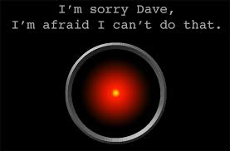
Output – printing to the screen
Generating output to the screen
The simplest way is using the print function.
print(”I am HAL 9000.”)
print(x, ’*’, y, ’=’, x*y)
A space is automatically placed between each item in the comma separated list that is being printed. A print always end with a newline.
If you don’t want to have spaces as delimitors or a newline in the end, then you can add sep=’’ and/or end=’’, like this:
print(’Hello’, ’world’, sep=’’, end=’’)
Which would give: Helloword
Printing is done to the screen - or more precisely - to STDOUT.
In strings you can use \n as the newline character and \t as the tab.

Slide 16

Conditional statements - basic
The most basic conditional statement in Python is a simple if-statement.
if condition:
some python statements
The condition is any expression that evaluates to true or false.
x > 10
height > 180 and weight < 60
The condition always ends with a colon.
Notice the indentation. It is very important.
There can be any number of Python statements as part of the if. They can be of all types, including more if’s.
The statements have to be indented to the same level for Python to understand they are part of the if.

Slide 17
Conditions in Python
Conditions are about comparing values to each other. Numbers are compared in the natural fashion, strings are compared alphabetically – or more correctly – according to the charaters placement in the ascii table – even more precisely – according to the bytes of the string.
Operator Meaning
== equal
!= not equal
> greater than
< less than
>= greater or equal
<= less or equal
There are more operators, but you can get very far with these.
More complex conditions can be made by using parenthesis and the keywords and and or, which binds simple conditions together, or not, which negates a simple condition. Example:
reply == ’OK’ or (strength > 30 and length < height/width)
You can only compare two values of the same type, else you have to typecast (change types). Floating points and integers can be compared directly, as they a both numbers.

Slide 18
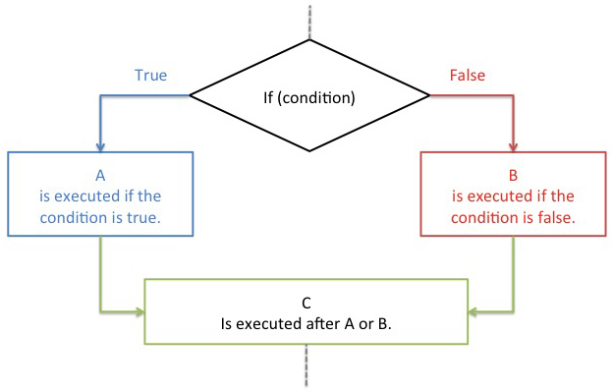
Conditional statements - advanced
An if-statement can be also be extended to execute code if the condition fails, not just success.
if condition:
statements # executed if true condition
else:
some python statements # executed if false condition
if-statements can be chained together in one big if. Conditions are tested in the order they appear and the corresponding block of python statements are executed, but not the rest.
if condition1:
some python statements # executed if true condition1
elif condition2:
some python statements # executed if true condition2
elif condition3:
some python statements # executed if true condition3
else:
statements # executed if no conditions are true

Slide 19
Conditional statements - conveniences
If a single simple statement is to be executed in the if-block
if height > 190:
highpersons += 1
Then the if can be written in one line, like this
if height > 190: highpersons += 1
This is quite expressive and uses only one line instead of two.
An example of an if inside an if – notice the indentation:
if height > 190:
highpersons += 1
if height > 220:
giants += 1

Slide 20
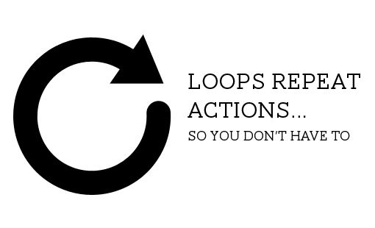
Loops – repeating statements
Loops are semantic constructs for repeating statements.
The easiest to understand loop is the for loop used for counting from one number to another.
for variable in range(start, stop, increment):
Or more practically – counting from 1 to 5 printing the numbers.
Notice that the stop is not part of the range.
for i in range(1, 6):
print(i)
The same result could of course be achieved like:
print(1)
print(2)
print(3)
print(4)
print(5)
But imagine that we are counting to 1000000.
How many times we repeat
What we repeat, notice indentation

Slide 21
Loops - again
The general loop is the while loop. It simply repeats the statements as long as the condition is true.
while condition:
statements
Expressing the for counting loop with while
i = 1
while i <= 5:
print(i)
i += 1
Notice: The incrementation of the looping variable is best left at the end of the loop.
There is no end to how many loops there can be inside each other.
How long should we repeat
What we repeat, notice indentation
Second statement to be repeated

Slide 22
Typecasting
It happens that you need to change type of a variable.
Sometimes because you need to compare two different values of different types, other times because you get some data in one form, but need it in another. A good example is the input function.
data = input(’Enter a number: ’)
The data returned by input is always a string, but here it is obviously needed as a number – so we typecast it to an integer.
data = int(input(’Enter a number: ’))
The int function returns an integer value of the input.
The float function returns a floating point value of the input.
The str function returns a string value of the input.
The functions will either succeed or give rise to an error. They will succeed if there is some meaningful conversion.

Slide 23
Indentation
Indentation has a syntaxical function in python and is essential.
The amount of indentation does not matter, but 4 spaces is the official standard. Limit all lines to a maximum of 79 characters.
Indentation shows the structure of the program/logic.
i = 1
while i <= 500:
print(i)
i += 1
if i % 10 == 0:
print(”Progess”)
In this example the numbers from 1 to 500 is printed, with a ”progess” report every 10th number. The if is part of the while body.
An official python style guide can be found at
https://www.python.org/dev/peps/pep-0008/
Lots of information……

Slide 24
Practical example of learned knowledge
Often you want to avoid executing parts of your code, f.ex. like when you make all the exercises in one script, but only want run the exercise you are currently working on.
Use the triple quote ””” or ''' to enclose the code you want to avoid.
”””
# Exercise 1
print(”Howdy”)
# Exercise 2
for number in range(1,10001):
print(”Number is”, number)
”””
# Exercise 3
# This code is executed
You probably did not think of this use of a string. When learning programming, you must reflect over the subjects taught. The language and the way you can apply it is strictly logical, and not everything that can be done, can be said in a lecture. You must reason it out yourself. It is a matter of applying logic and consequence and if you are not certain about what you are doing, make a small test in python.

